Slide 1
Stock Management,Profit & Loss prediction Project guide: Project Coordinator: Ms Eden Jesleen Sequeira Ms Lavina Jean D’silva Assistant Professor, CSE Assistant Professor, CSE
Team members:
Adnaan 4SO16CS007
Manoja Krishna Damale 4SO16CS057
Maxim Vishal Monteiro 4SO16CS060
Mohammed Hakeeb Javid 4SO16CS064

Slide 2
Problem Statement :
The aim of the application is to choose an accurate vendor for some particularly specified product.
The growth of any organization depends on the profit gained on the product and this profit is gained only if the best vendors are chosen.
If there is no on time delivery of product from the vendor or if there is supply damages and if the purchase price of the product is expensive then there occurs a huge loss to the organization.
Objective :

Slide 3
Introduction
Stock Management, Profit and Loss prediction application makes use of machine learning algorithms to predict the good vendors.
Algorithms such as SVM (Support vector machine) and SKfuzzy is used in the application. Interface takes the user inputs such as product id ,quantity, supplier id, tax, price.
Finally, SVM it is going to predict whether we need to go with that vendor or not.
SKfuzzy algorithm is an approach to predict the comparison between the vendors within the stock.
Performance is based on the above parameters and the profits percentage for that supplier is calculated. The products yielding profit is shown in category by applying statistical analysis.

Slide 4
Hardware Requirements
Laptop/Personal Computer
Processor : Intel Core i3-3110M
RAM : 4GB or above
Software Requirements
Operating System : Windows 7 or above
Web Interface (Frontend) : HTML & CSS
Programming Language : Python
Cross platform web server : Flask

Slide 5
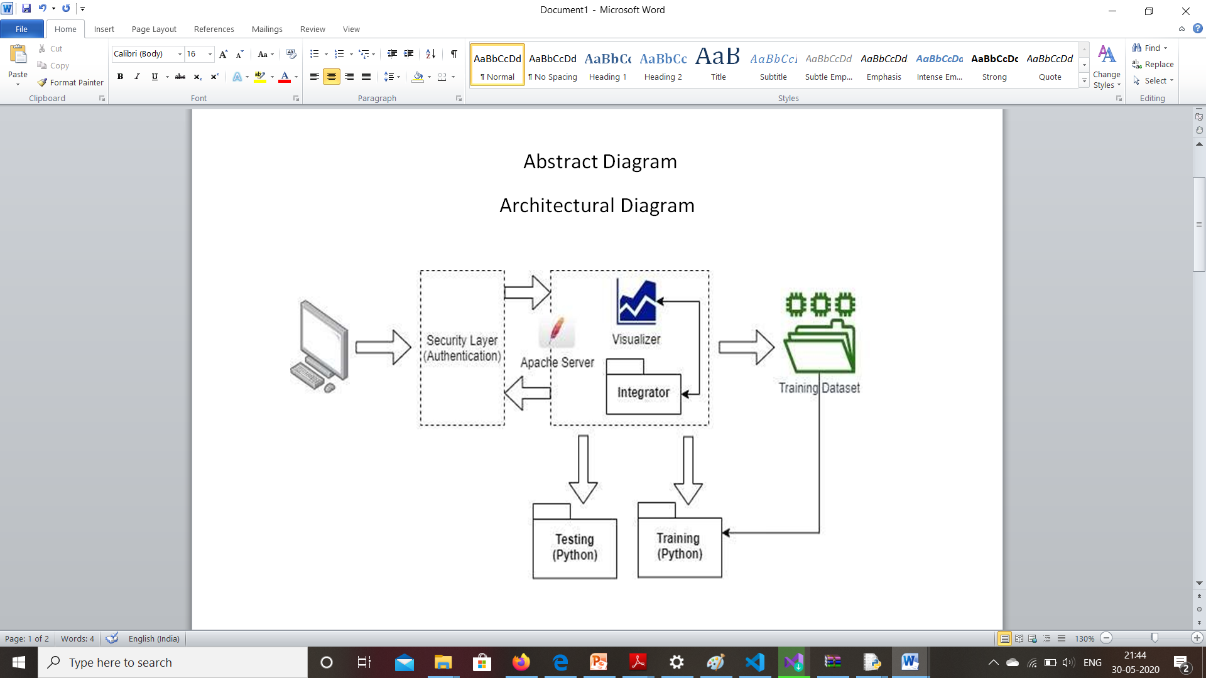
Design

Slide 6
Algorithm
Signup page to the new application user
Begin
If (Name,Email) Then
If (Length of password > 4) Then
Signup()
Display “Registration Successful”
Else
Display “Authentication failed. The given password is invalid”. [Password should be at least 6 characters.]”
EndIf
Else
Display “Enter all the details”
EndIf
End

Slide 7
2. Login page to the Application user
Begin
If (Name and Password) Then
If (Name and Password is valid) Then
Login()
Display “Login Successful”
Else
Display “Authentication Failed”
EndIf
Else
Display “Enter all the required details”
EndIf
End

Slide 8
3. Prediction page to predict the vendor for a product
Begin
If ( Product_id, Quantity, Price , Supplier_id ,Tax ) Then
Predict() [prediction based on profit from that vendor] Then
If (The products yields profit with that vendor) Then
Display “good choice”
Else
Display “not good choice and take up alternative measures”
EndIf
Else
Display “Enter all the required fields”
EndIf
End

Slide 9
Test cases :
Signup page for the New application user
Table 1: Test case for Signup
SI.No | Test Cases | Expected output | Observed output | Result
1. | When Name,Email, Password entered is correct | Home page | Home page is displayed | Pass
2. | When name is not entered | Display “Enter Name” | “Enter Name” is displayed | Pass
3. | When email is not entered | Display “Enter email” | “Enter Email” is displayed | Pass
4. | When Password is not entered | Display “Enter password” | “Enter password” is displayed | Pass
5. | When password is less than 4 characters | Display “Minimum 4 characters required” | “Minimum 4 characters required” is displayed | Pass

Slide 10
Login page for the application user
Table 2: Test case for Login
SI.No | Test Cases | Expected outcomes | Observed output | Result
1. | When name and password entered are correct | Display Home page | Home page is displayed | Pass
2. | When name entered is incorrect | Display “Invalid name” | “Invalid name” is displayed | Pass
3. | When password entered is incorrect | Display “Invalid password | “Invalid password” is displayed | Pass

Slide 11
Prediction page to predict the vendor for the product
Table 3: Test case for Prediction
SI.No | Test Cases | Expected Output | Observed Output | Result
1. | Enter product_number, tax Quantity,price, supplier_id | Go ahead & looks goods | Display’s “Its good and go ahead” | Pass
2. | Enter product_number,tax Quantity,price, supplier_id | Not a good choice | Display’s “It’s not good to go & take alternatives” | Pass
3. | If product_number & product price does not match | Not a good choice | Display’s “It’s not good to go & take alternatives” | Pass
4. | If Quantity is invalid | Not a good choice | Display’s “It’s not good to go & take alternatives” | Pass
5. | If product number is invalid | Not a good choice | Display’s “It’s not good to go & take alternatives” | Pass
6. | If supplied_id entered is invalid | Not a good choice | Display’s “It’s not good to go & take alternatives” | Pass
7. | If Tax is not a valid number | Not a good choice | Display’s “It’s not good to go & take alternatives” | Pass

Slide 12
Analysis
Need of improving available dataset to fit the training model..
To use a proper database inorder to customize the time complexity .
Need of using relevent technology to eliminate time complexity due to large amount of data in the front end.
Eliminating the redundant data before it is used by the training model for processed bybtraining rules.
Improve the training rule to get an most accurate result for a fair evaluation of performance of suppliers, product, produxt category.

Slide 13
Conclusion
Able to map the exact intelligence with the best understanding of our need to process the application and the algorithm.
Able to process the application with the different algoritic intelligence and decide the best one that fits
Used micro database system like flask and learning the use of it.
Made the best and the most use of the dataeset by clustering and trying different combination of it.
Reflected the aim of the project theough the front end. Making it user readable and understandable using different graph representation’s.

Slide 14
References
[1]. F. Hedderich, R. Giesecke, and D. Ohmsen. “Identifying and evaluating Chinese suppliers”: China sourcing practices of German manufacturing companies. Practix, 9:1–8, (2006).
[2]. L.M. Ellram. “Total cost modelling in purchasing”. (1994). Centre for Advanced Purchasing Studies
[3]. Arthur L. Corbin. Corbin on Contracts. Matthew Bender & Company, Inc., (2007)
[4]. Parmar ,"Stock Market Prediction Using Machine Learning," 2018 First International Conference on Secure Cyber Computing and Communication (ICSCCC), Jalandhar, India, 2018
[5]. S. M. Idrees, M. A. Alam and P. Agarwal, "A Prediction Approach for Stock Market Volatility Based on Time Series Data", 2019
[6]. N. Yang, X. Jin, T. Su and J. Kong, "Multisource Data Analysis for Stock Prediction," 2018 10th International Conference on Modelling, Identification and Control (ICMIC), Guiyang, 2018

Slide 15
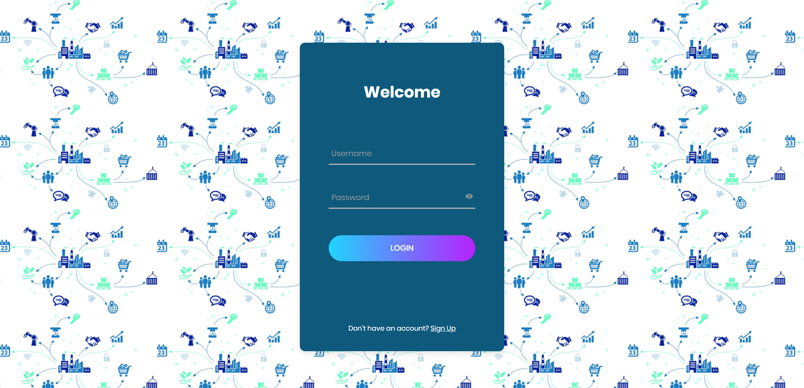
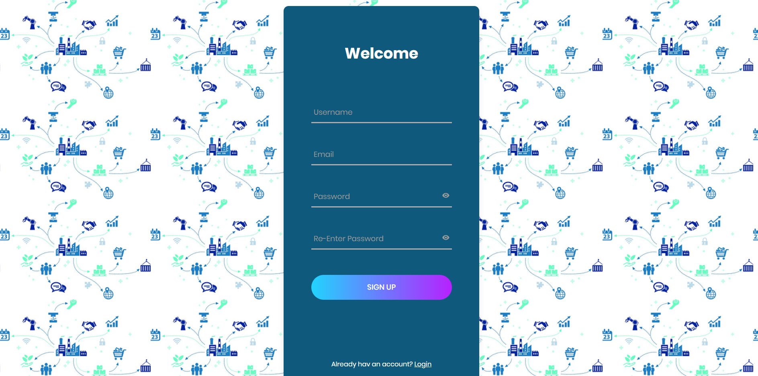
Screenshots :
Figure 1. Login page
Figure 2. Signup page

Slide 16
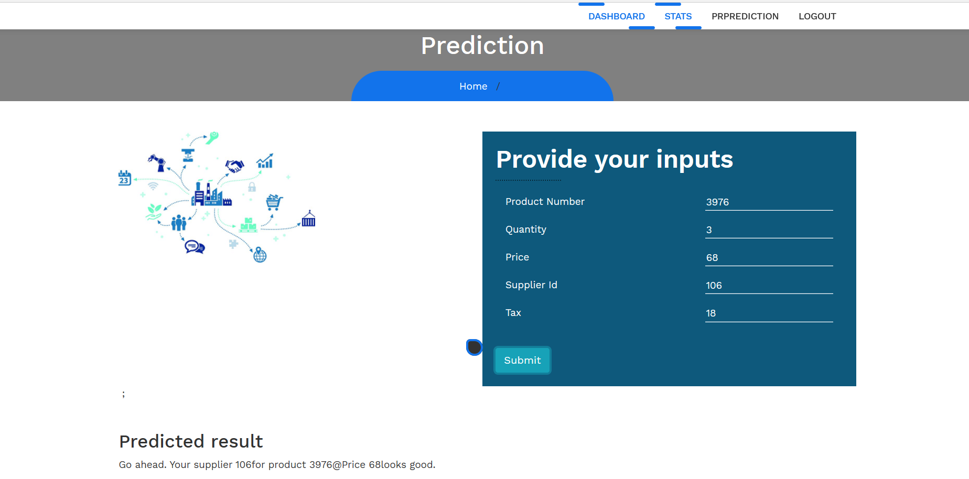
Figure 3. Vendor Prediction page for a good choice

Slide 17
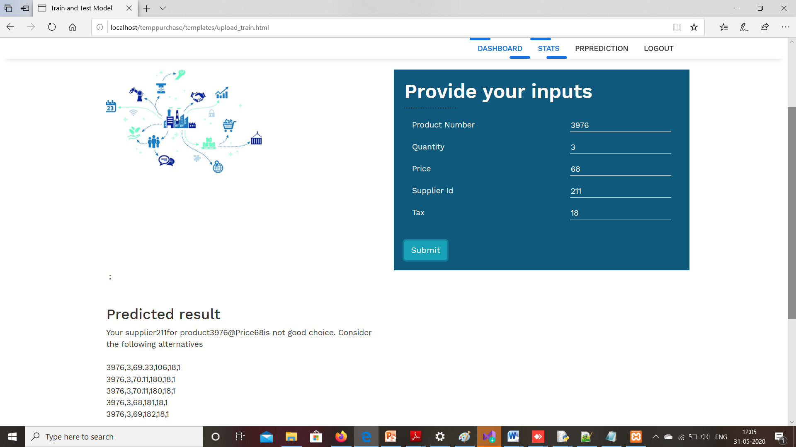
Figure 4. Vendor Prediction page for not a good choice

Slide 18
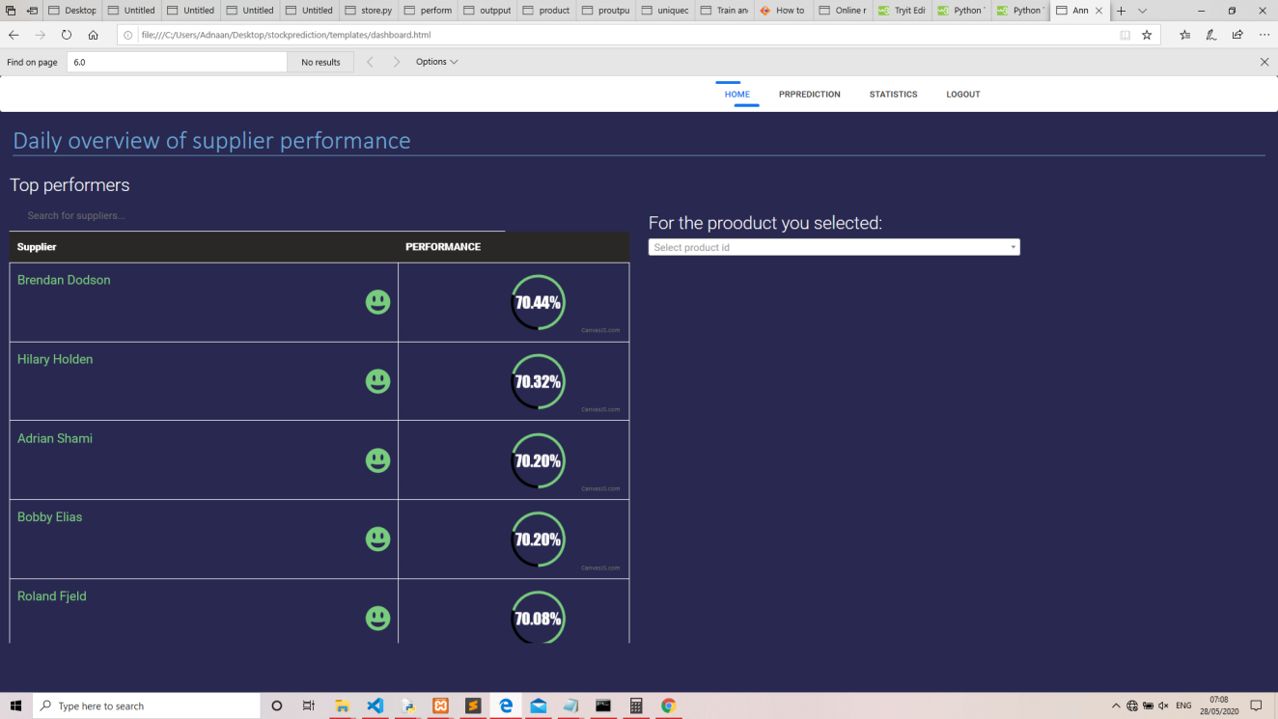
Figure 5. Page displaying the top performers

Slide 19
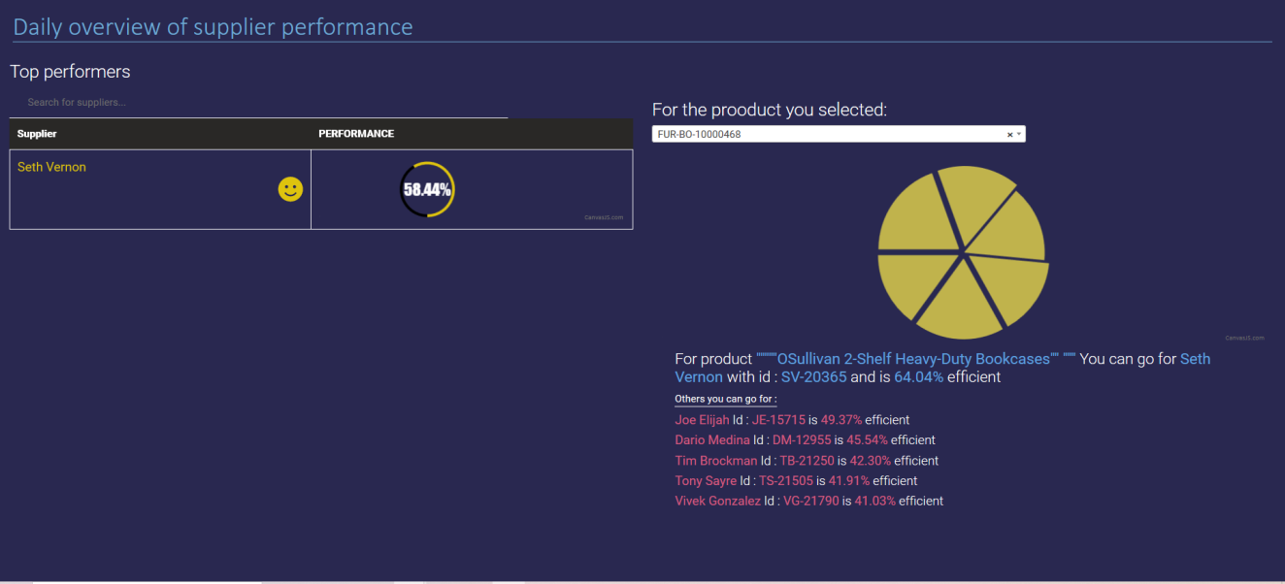
Figure 6. Suggest supplier to the product.

Slide 20
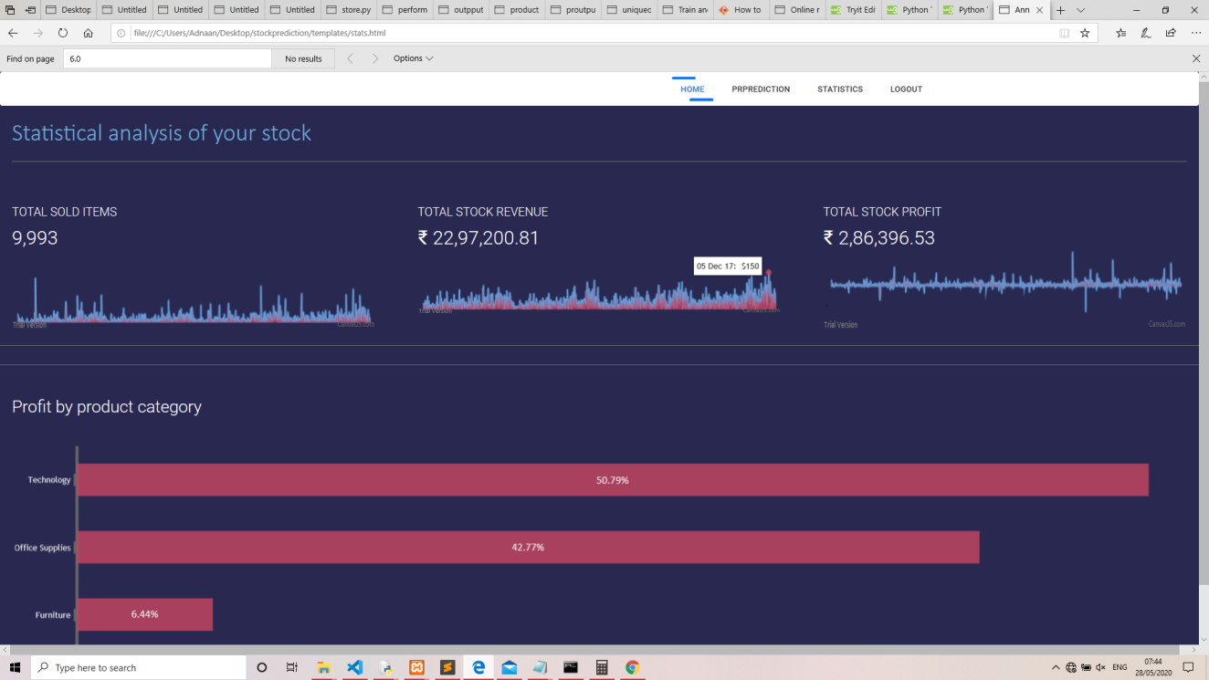
Figure 7. Statistical analysis of the stock by quantity by date,sales by date,profit by date and profit by category

